Slide 1
CCAT Map Making Update
February 7th 2025
Jonah Lee

Slide 2
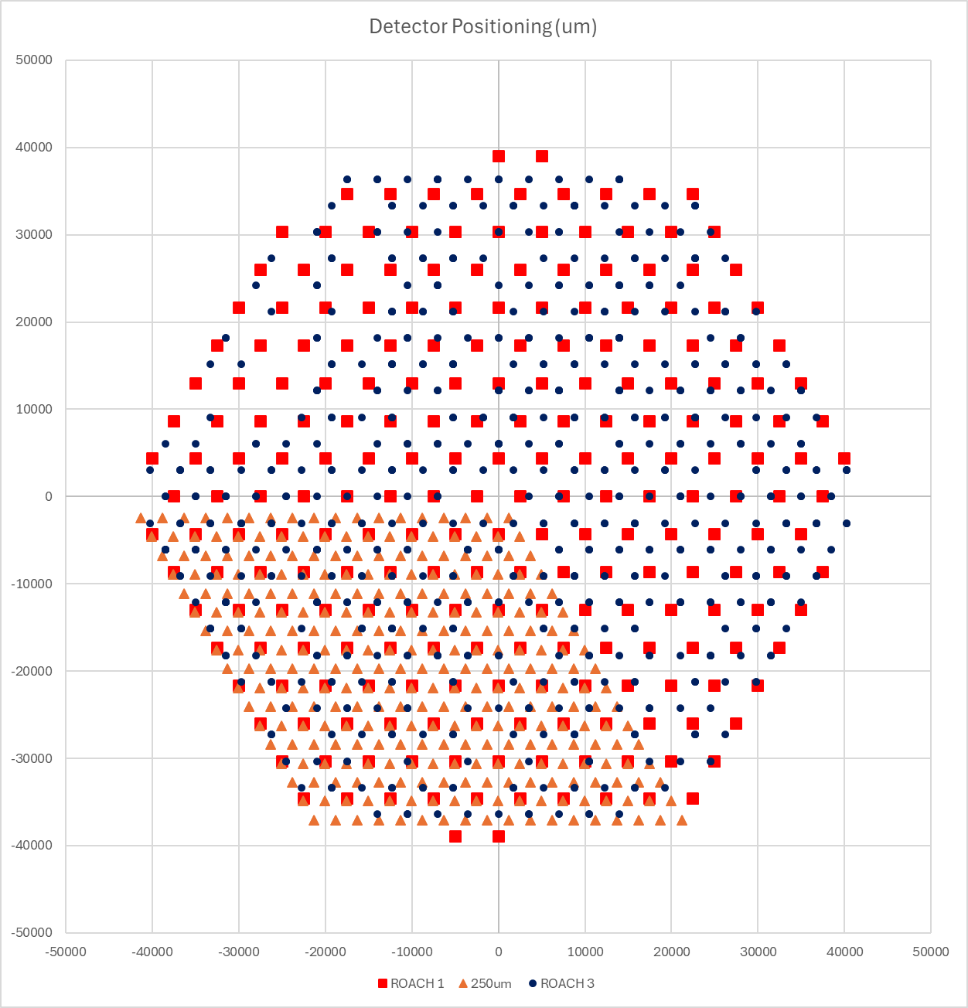
How Does Common-Mode Signal Vary Across Networks?
BLAST-TNG Network Configuration: 5 ROACHes (Reconfigurable Open Architecture Computing Hardware)
500μm - ROACH 1
350μm - ROACH 3
250μm - split into 3 rhombi:
ROACH 2
ROACH 4
ROACH 5
Are there common signals on each network that differ for reasons other than on-sky position?
→ Analyze 250μm ROACHes to control for wavelength & detector type

Slide 3
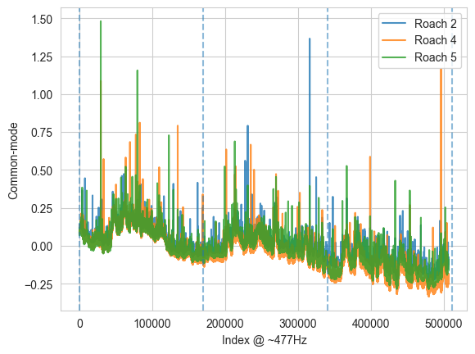
Time Domain
Vertical lines segment time into the three 6-minute passes.
Common-mode is the mean value of the calibration lamp normalized DF TODs for each network.

Slide 4
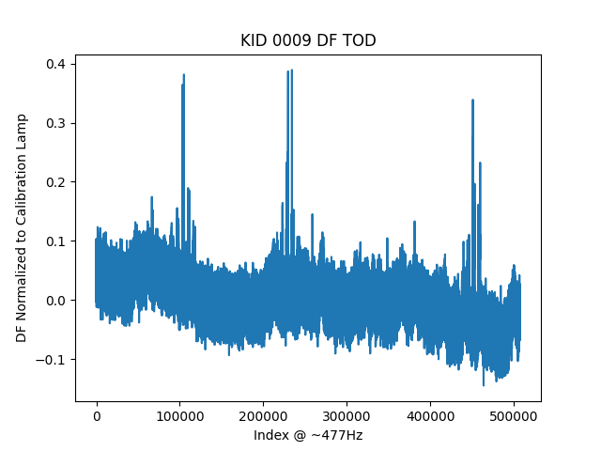
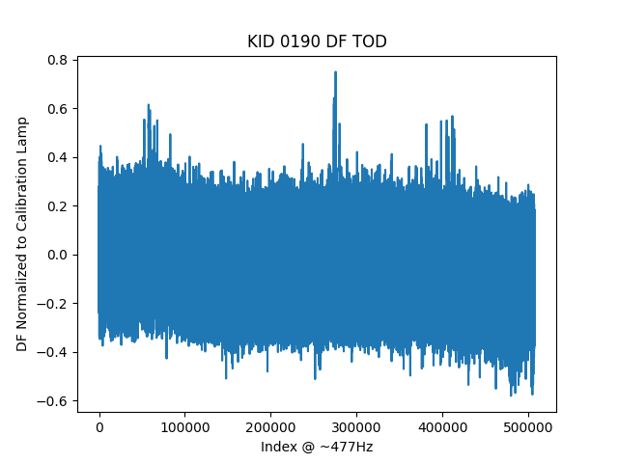
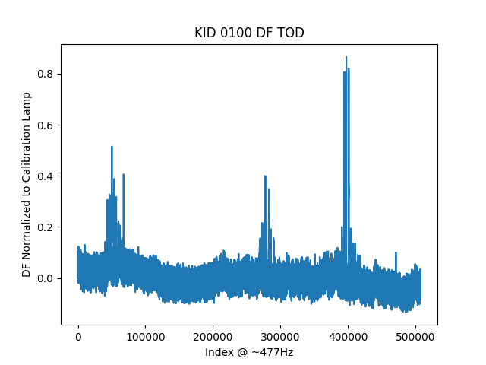
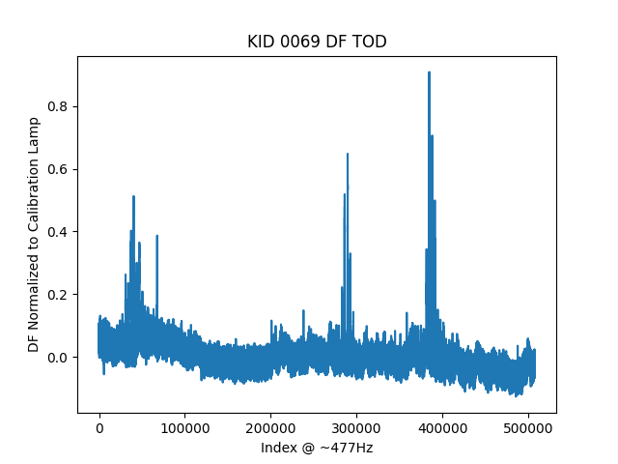
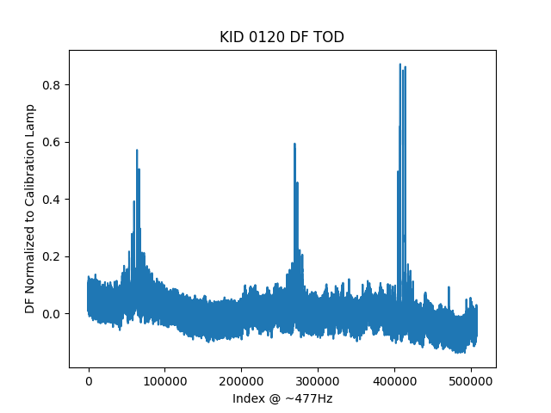
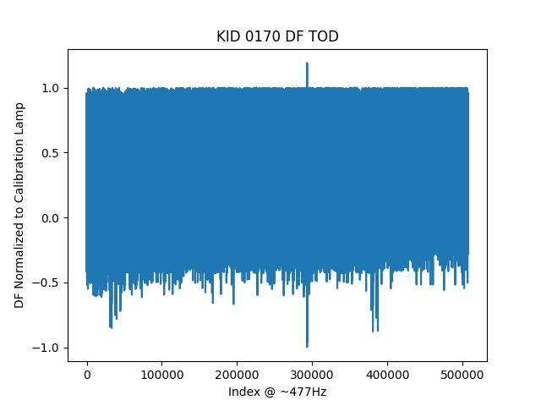
Single (Randomly Selected) KID Samples - ROACH 1

Slide 5
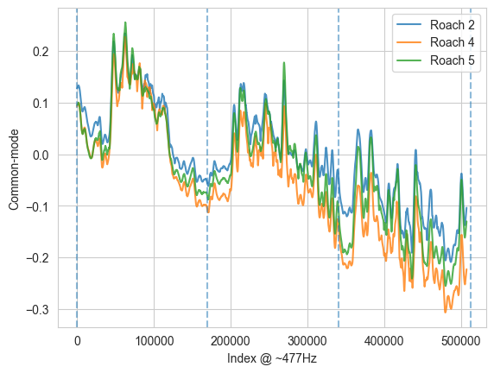
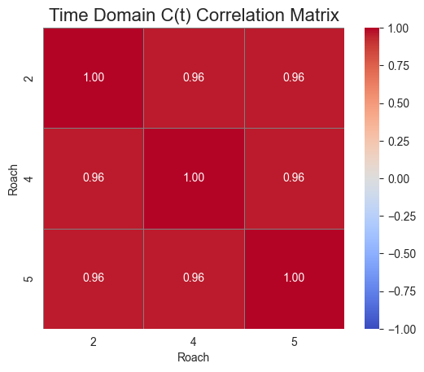
Time Domain (filtered)
Savitzky-Golay filter. Window = 2000 Poly. Deg. = 1

Slide 6
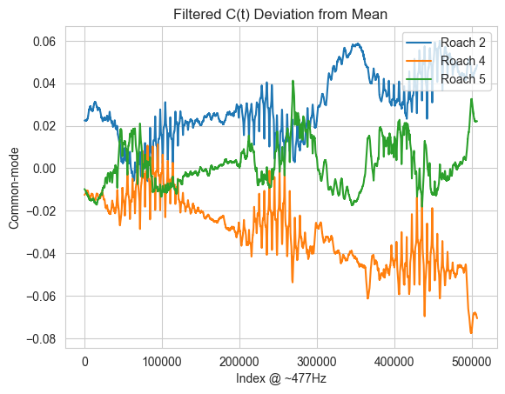
Differences Between 250μm Roaches
Slight trend over time
Spikes in differences as telescope scans over source
The arrays do not scan past source synchronously since they are positioned differently on the image plane
Can these effects be explained by the different positions of the arrays, or are instrumental differences at play?
Telescope Passes Source

Slide 7
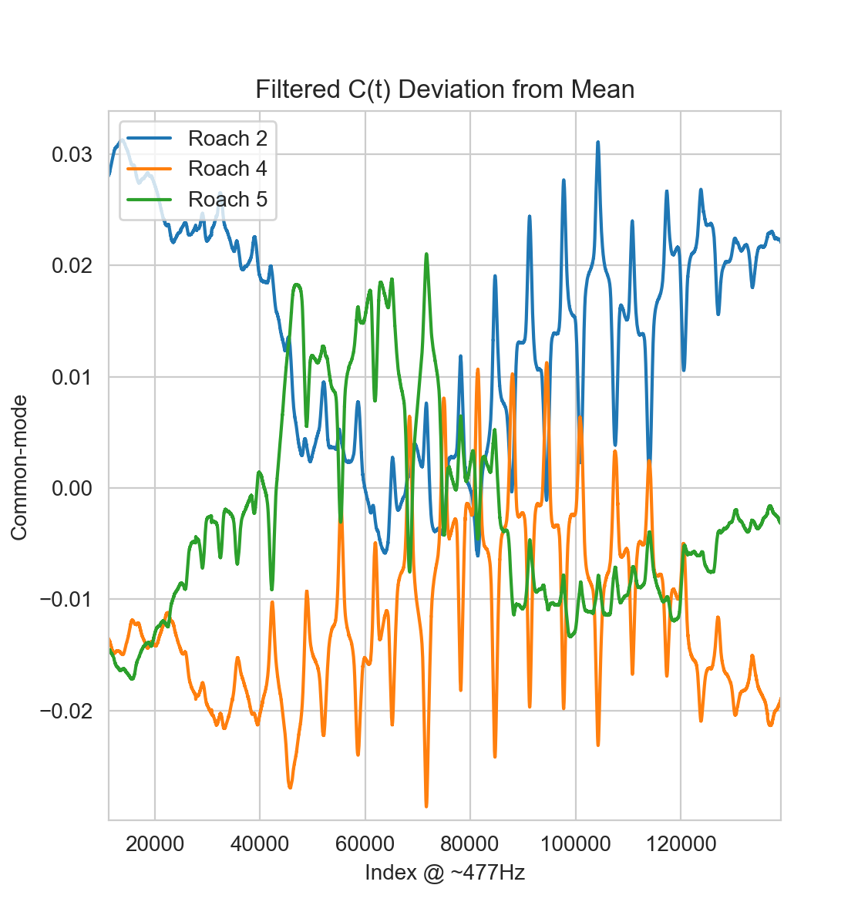
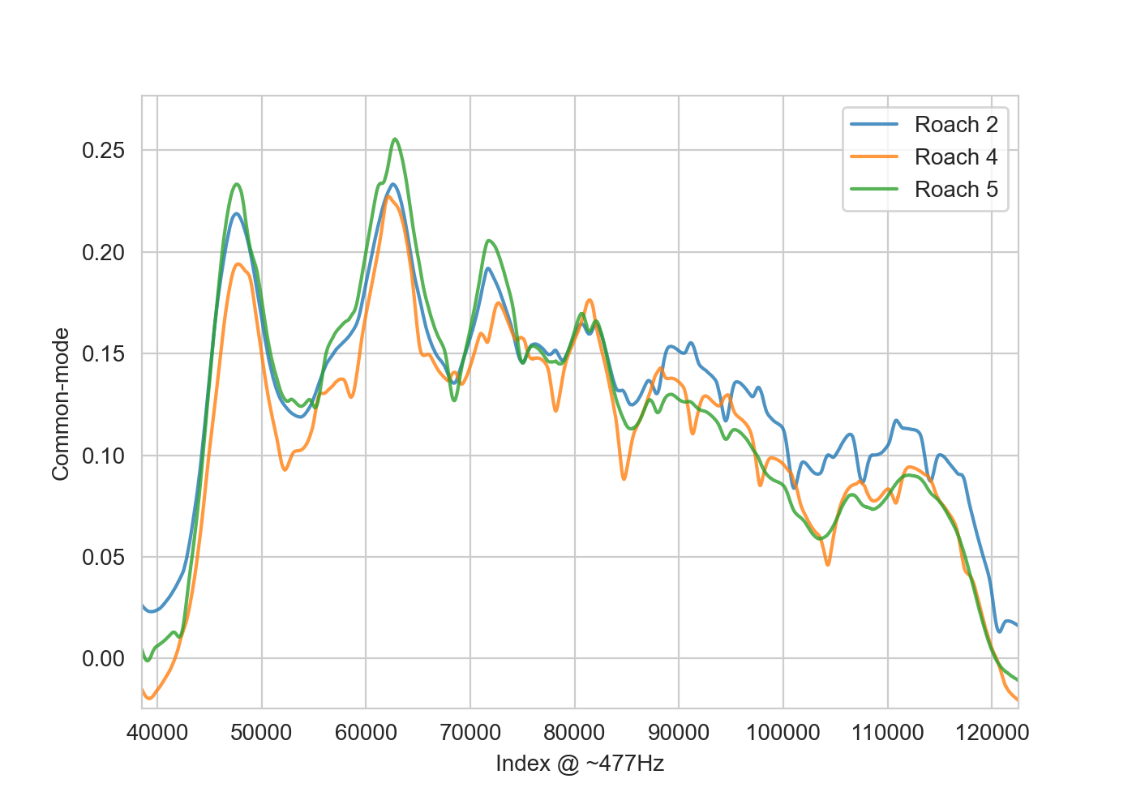
Differences Between 250μm Roaches
Zoomed in to first source pass
Filtered C(t)

Slide 8
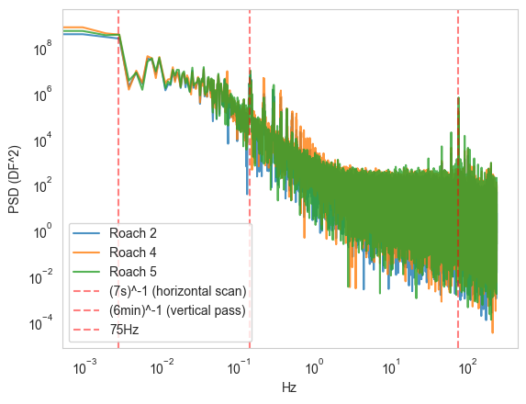
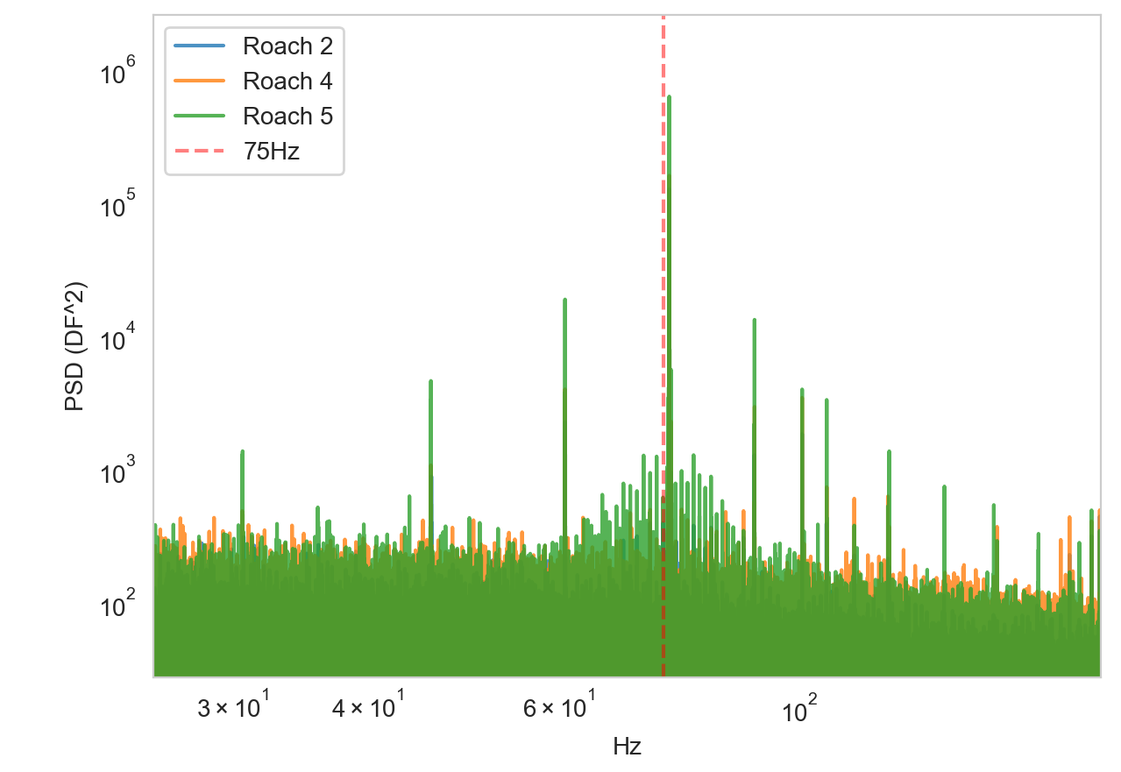
Frequency Domain
Close match in low frequency terms
Shared peaks at:
1/7 Hz - horizontal scan frequency
75Hz - pump frequency

Slide 9
Filtering Bad Detectors

Slide 10
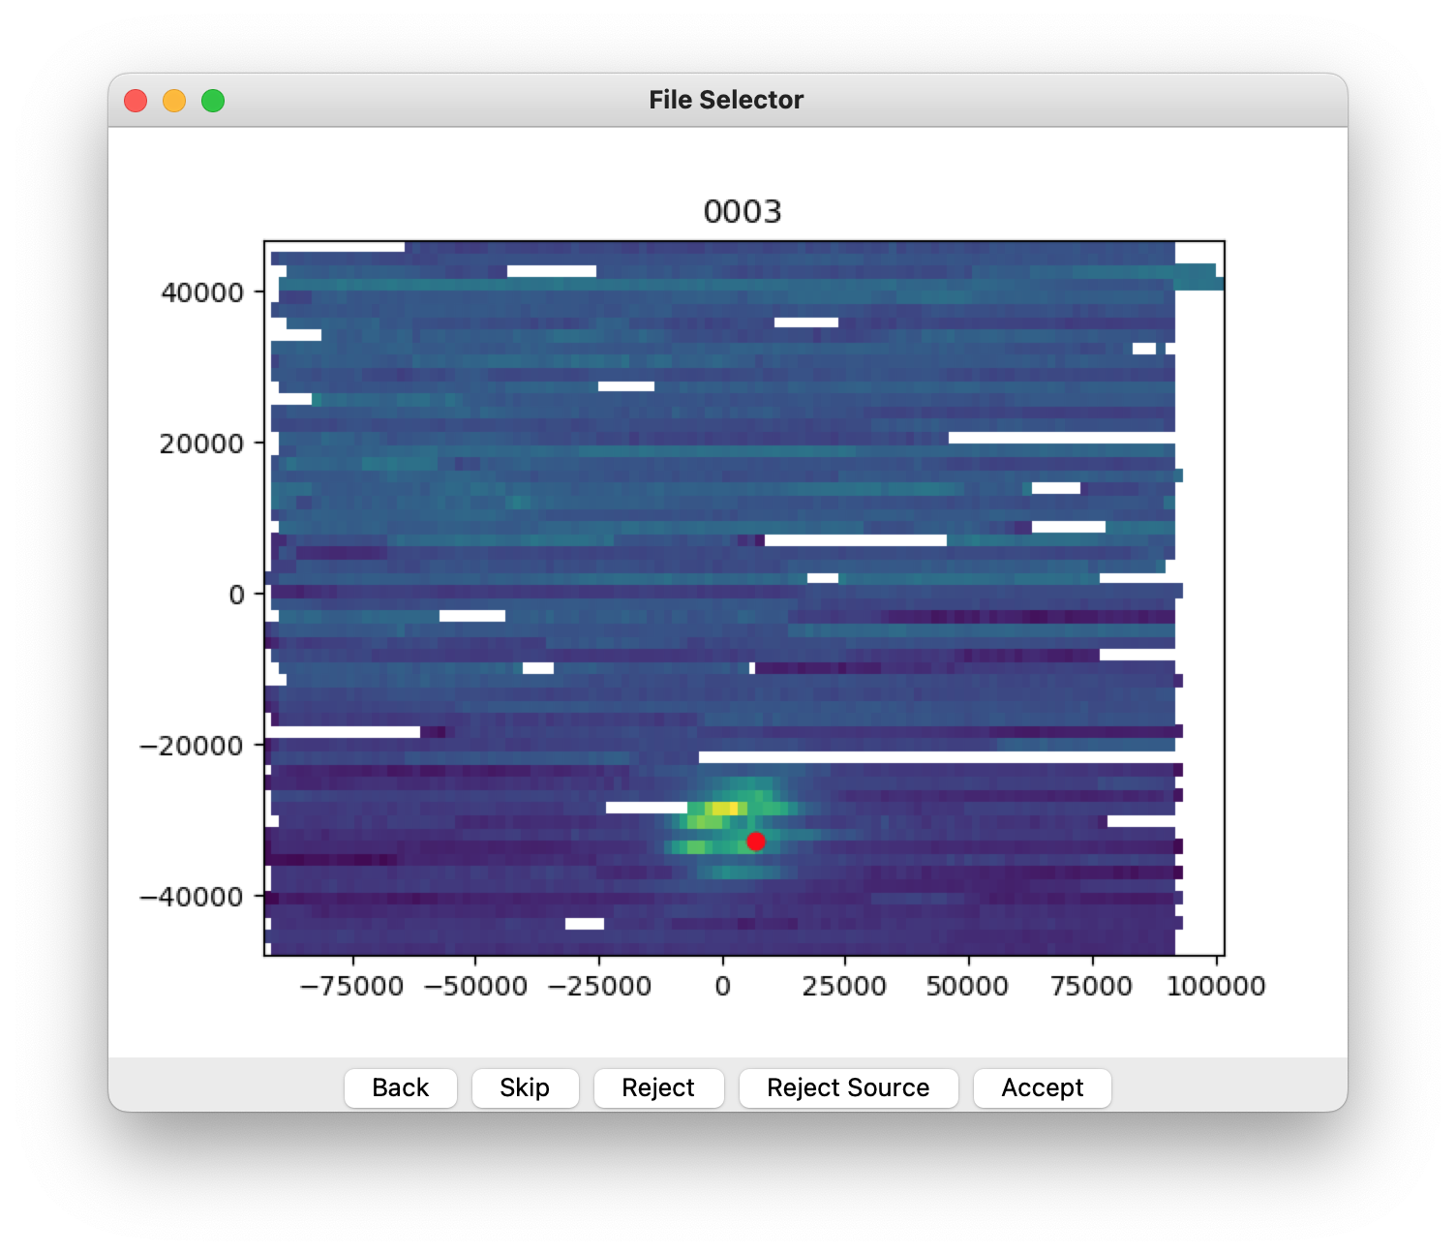
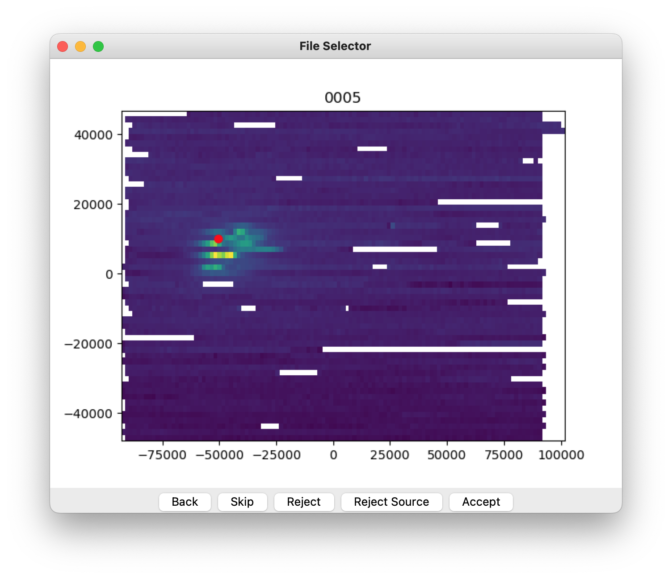
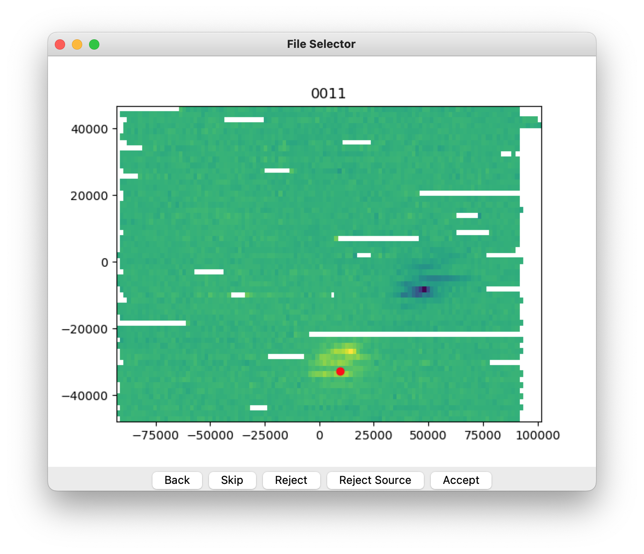
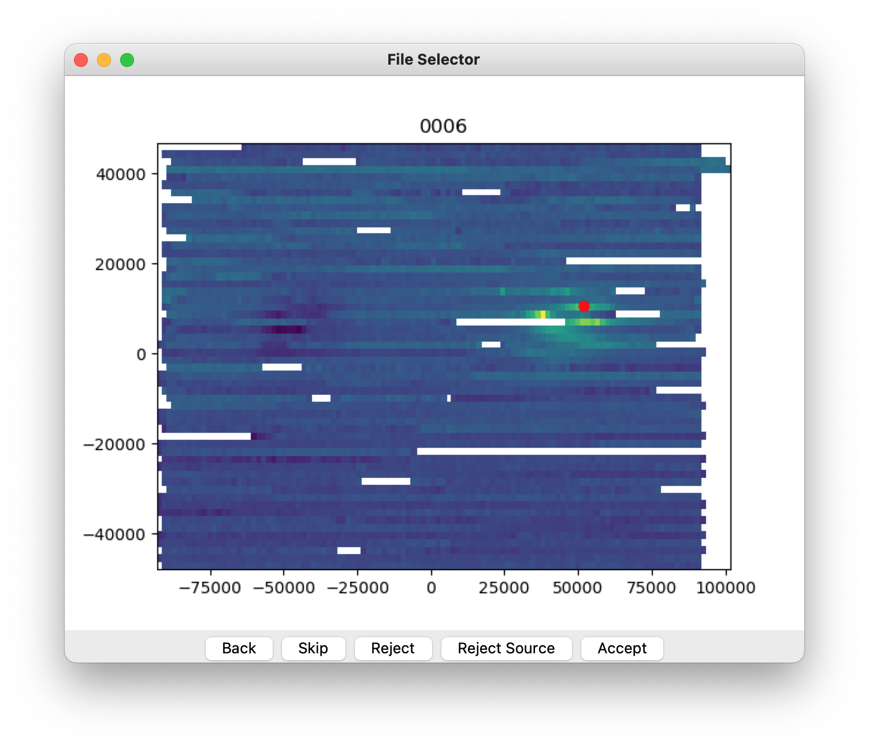
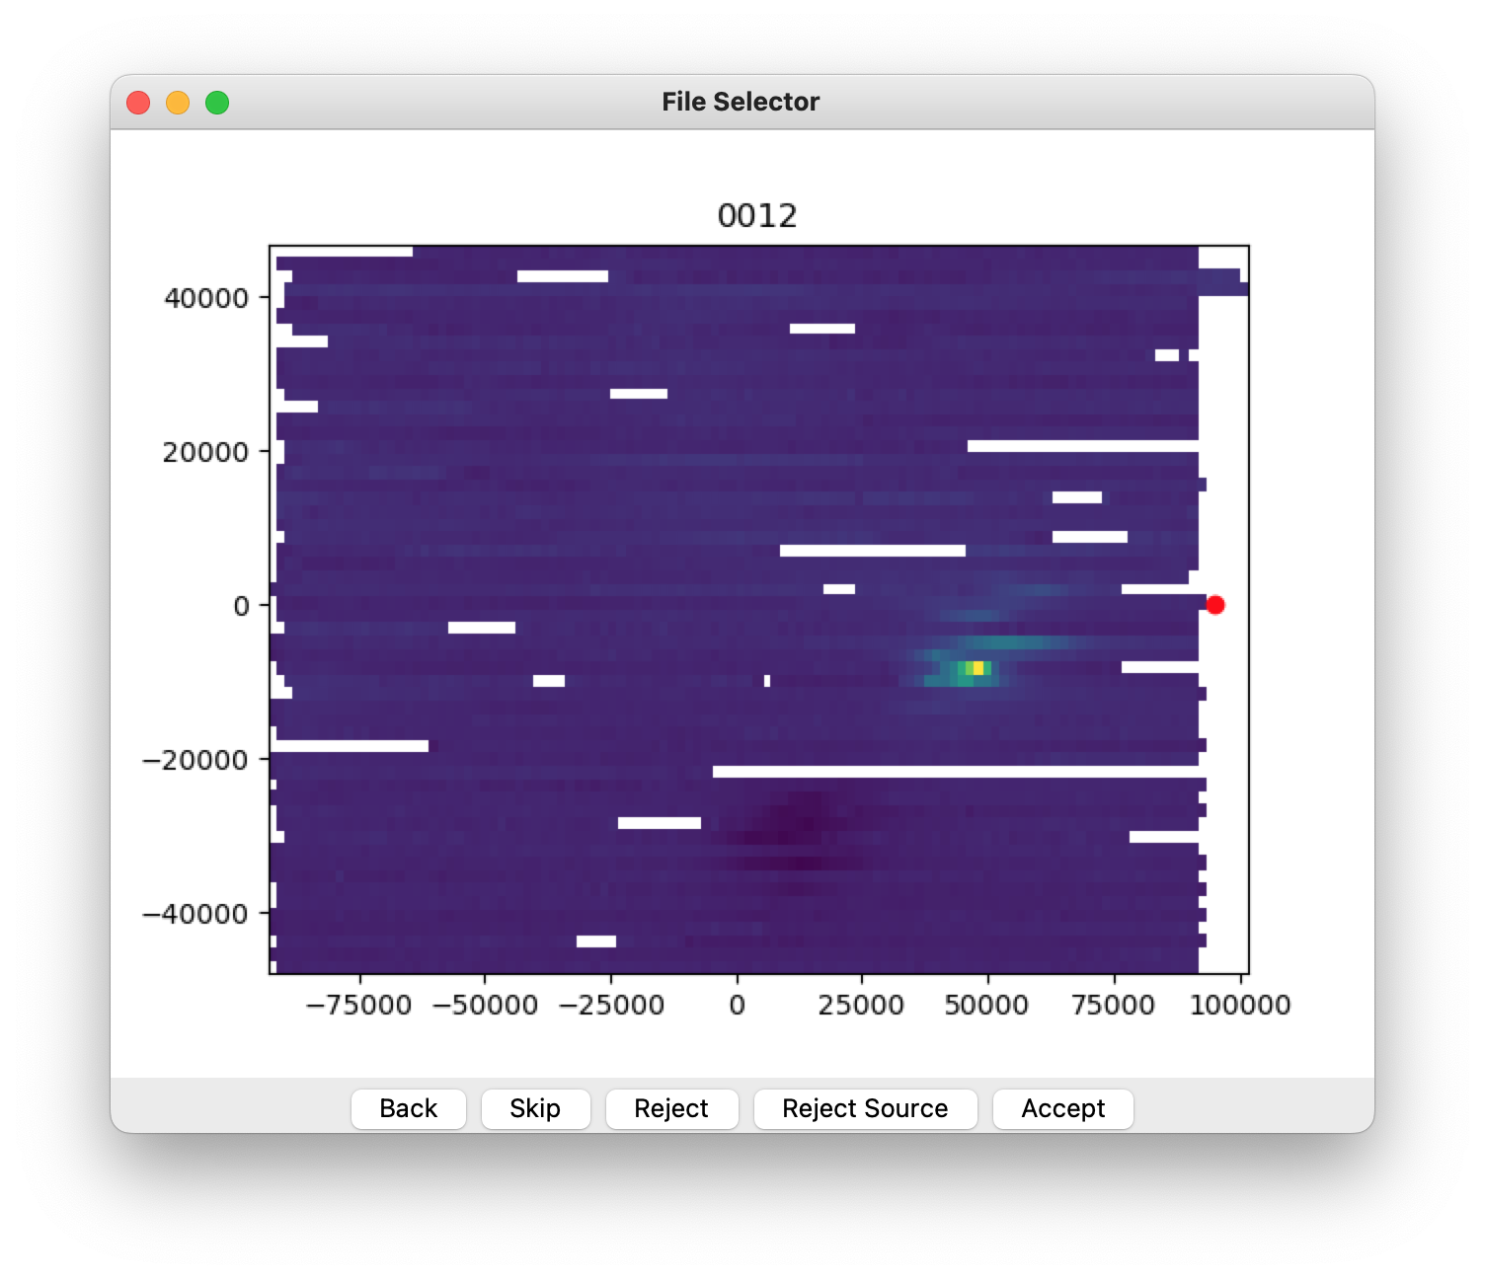
App: Manual filter
Source: James Burgoyne

Slide 11
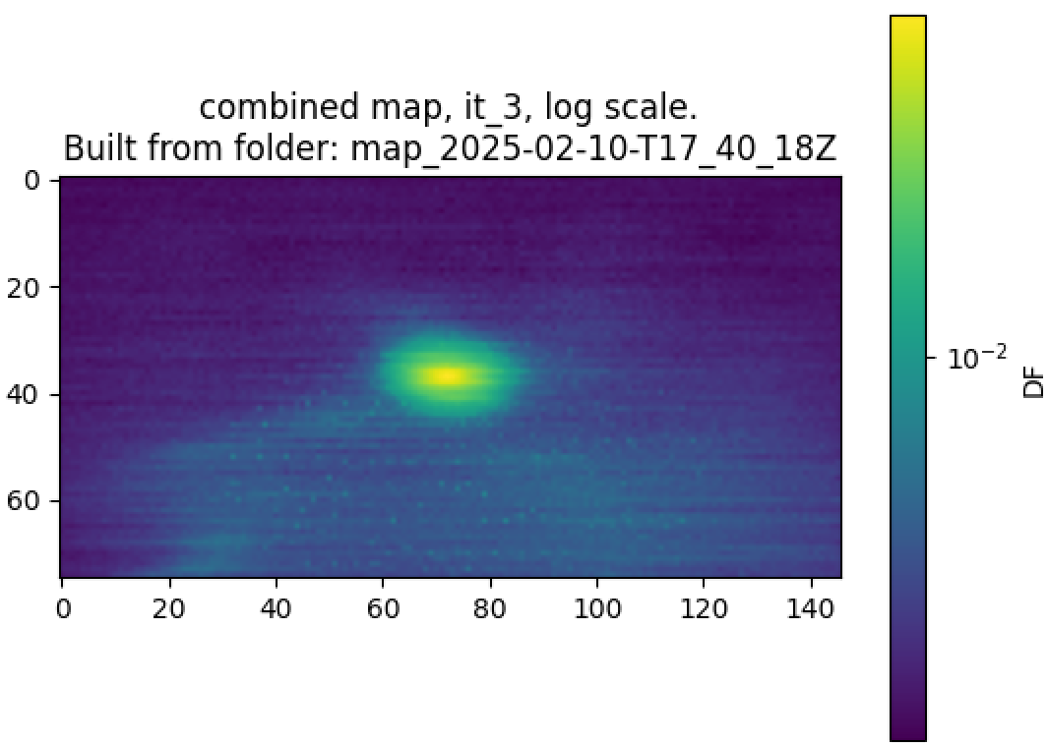
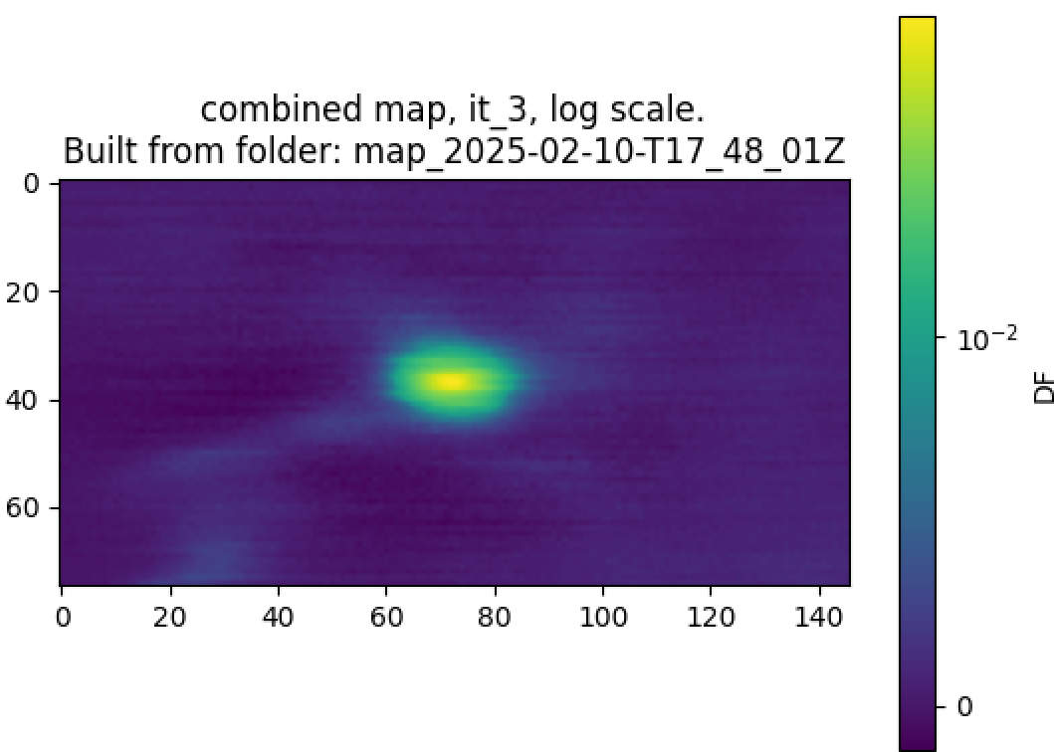
Bad Detector Removal
Before (Roach 1, 3 iterations):
Bad KID rates from manual filtering:
500μm -- 10%
250μm -- 22%
350μm -- 13%
Can be automated
Several possible techniques, not necessarily KID specific
After (Roach 1, 3 iterations):
Notes:
500μm 39/380
250μm (108/473+139/497+64/450)/3
350μm 90/667

Slide 12
Future Directions
Develop flexible “Toolbox”
Set of highly configurable processing tools (e.g. TOD filters, destriping tools, etc.)
Code base options
Custom code base, based on established map-making strategies (e.g. SMURF)
Work with KID data from CCAT detector arrays
Use LED array to generate simulated data for development

Slide 13
Appendix

Slide 14
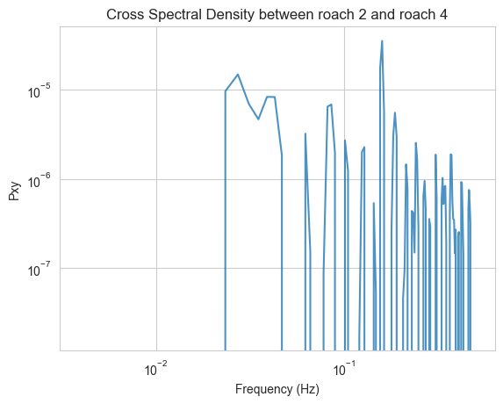
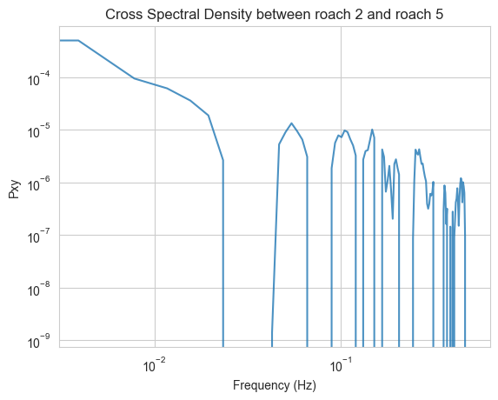
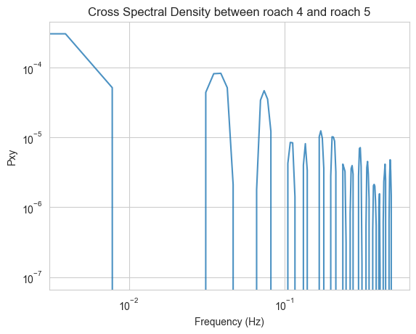
Cross Spectral Density

Slide 15
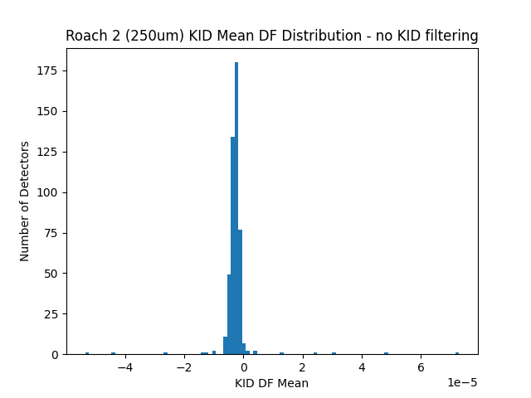
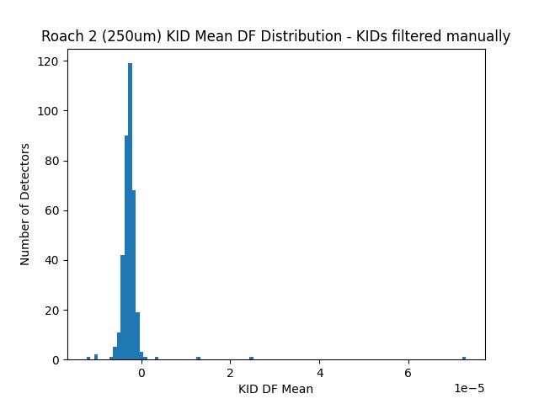
KID Amplitude Distribution
Before and after manual KID filtering:

Slide 16
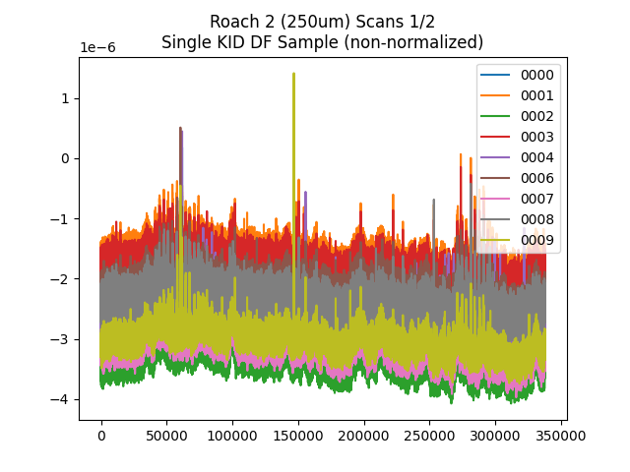
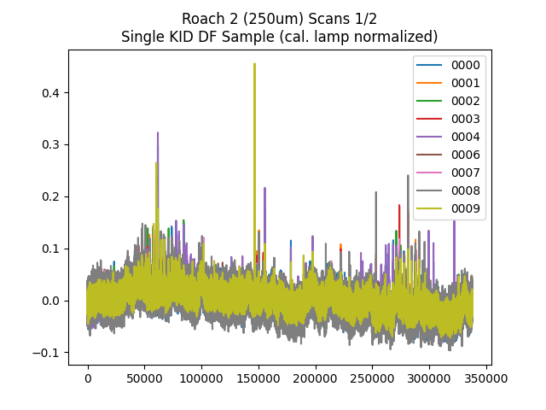
Calibration Lamp Normalization
Time (index @ ~477Hz)

Slide 17
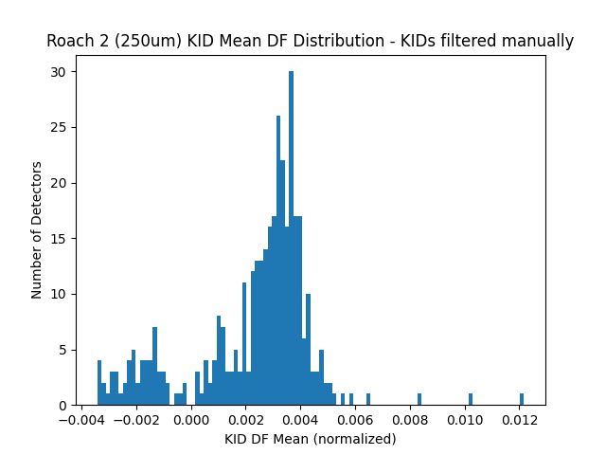
KID Amplitude Distribution
Before and after normalizing to calibration lamp:

